Slide 1
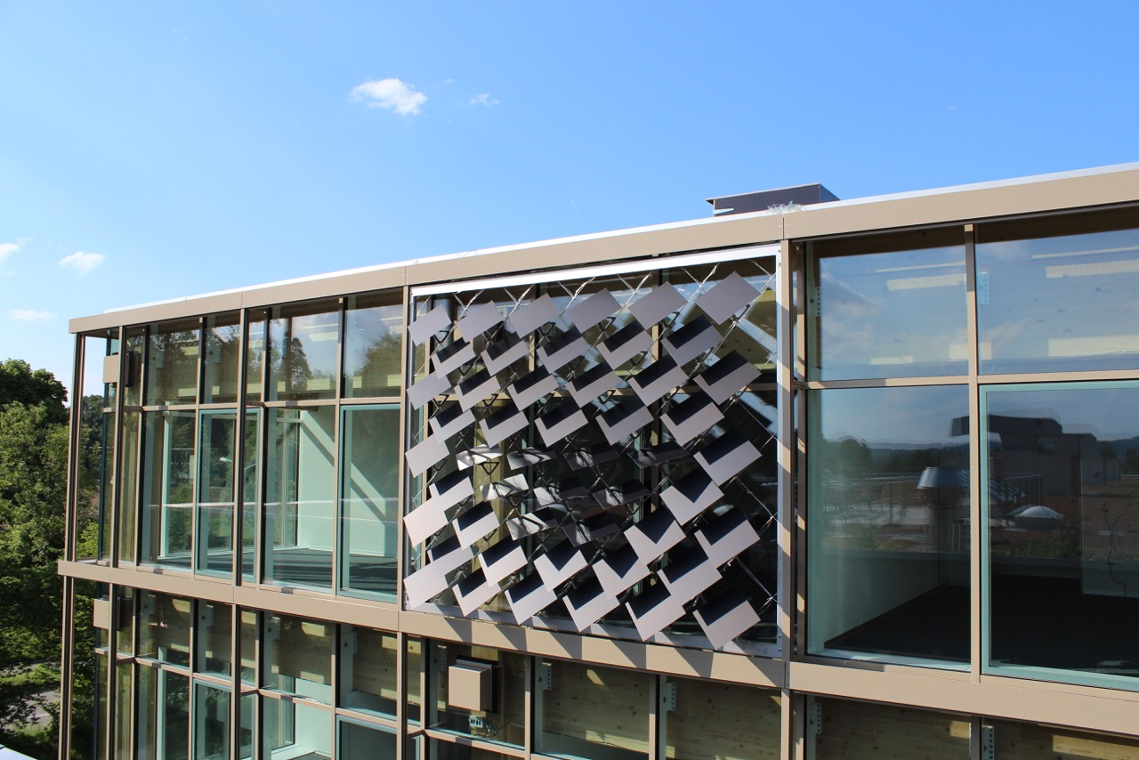
Numerical Analysis of the Adaptive Solar Façade
Jeremias Schmidli
Supervisor: Prageeth Jayathissa

Slide 2
The Adaptive Solar Façade (ASF)
Individually Actuated Panels
Combines Dynamic Shading with PV-Electricity Production
Needs to be Optimized for Cooling, Heating, Lighting, Actuation and PV-Electricity Production

Slide 3
Overview
Introduction
Problem Description
Methodology
Results and Discussion
Conclusions and Outlook

Slide 4
Overview
Introduction
Problem Description
Methodology
Results and Discussion
Conclusions and Outlook

Slide 5
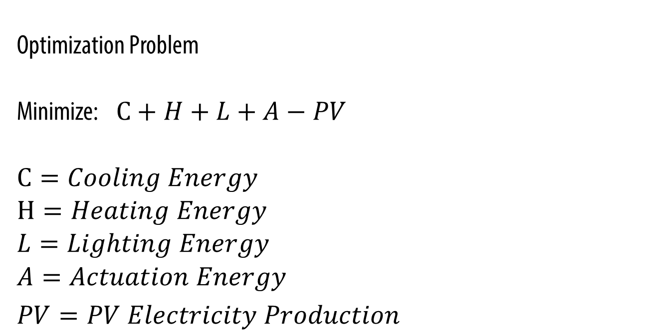
Problem Description
Optimization Problem
Minimize: $C+H+L+A−PV$
$C=Cooling Energy$
$H=Heating Energy$
$L=Lighting Energy$
$A=Actuation Energy$
$PV=PV Electricity Production$

Slide 6
Overview
Introduction
Problem Description
Methodology
Results and Discussion
Conclusions and Outlook

Slide 7
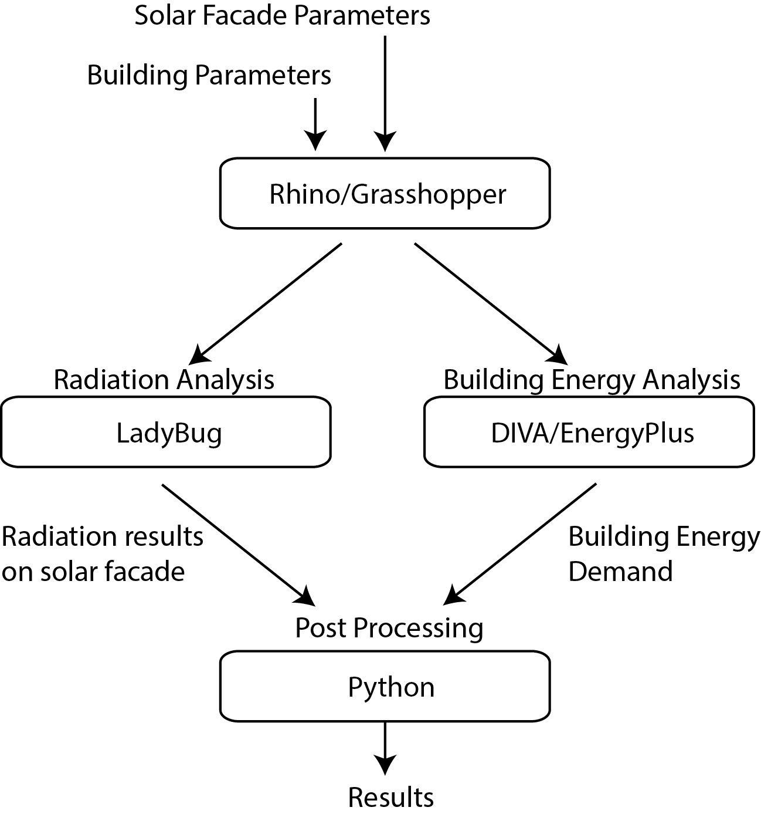
Methodology
Combination Of Different Tools To Achieve Optimal Results

Slide 8
Overview
Introduction
Problem Description
Methodology
Results and Discussion
Conclusions and Outlook

Slide 9
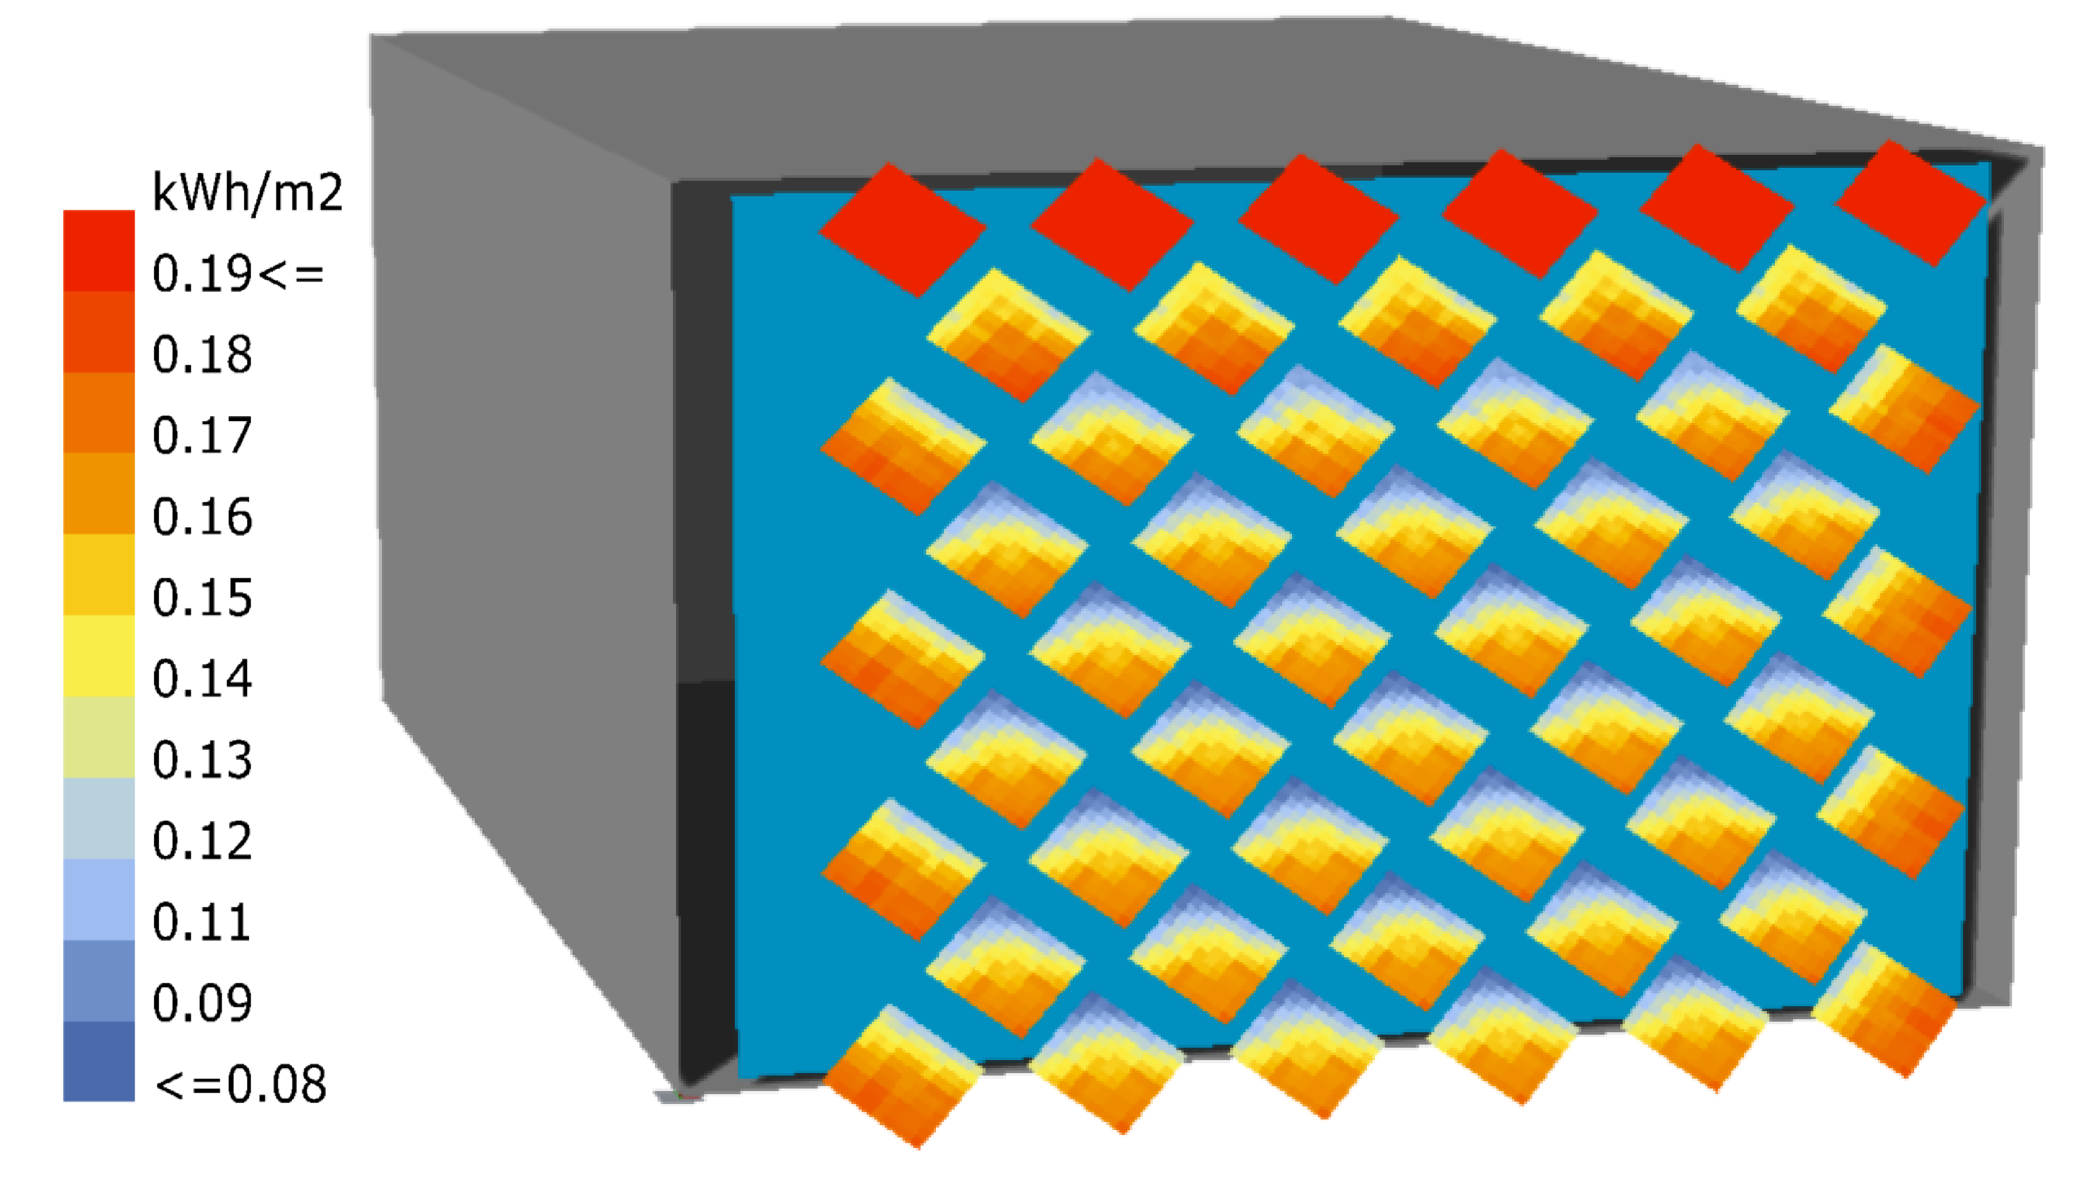
Radiation on Panels
Radiation Analysis with Ladybug
Includes Self-Shading
Insolation from 11:00-12:00 on June 16

Slide 10
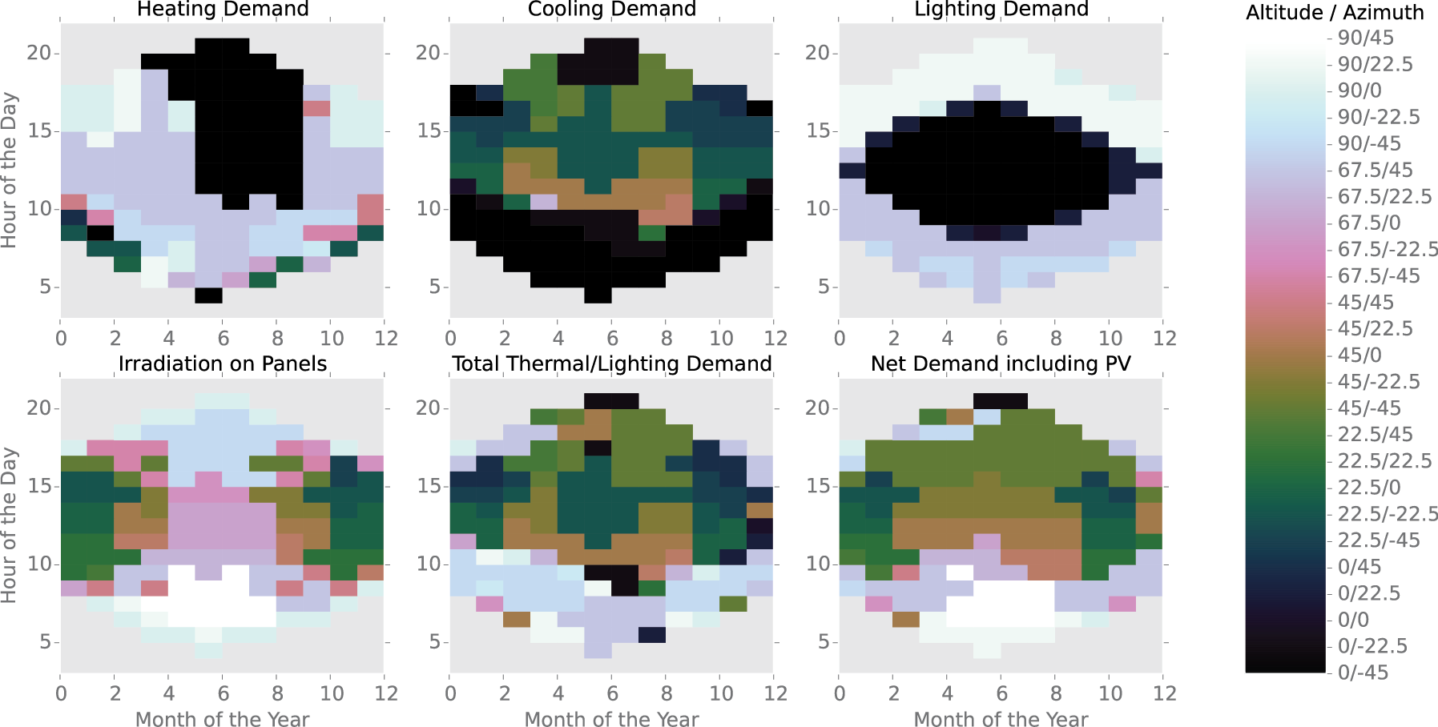
Optimum Orientation of Panels

Slide 11
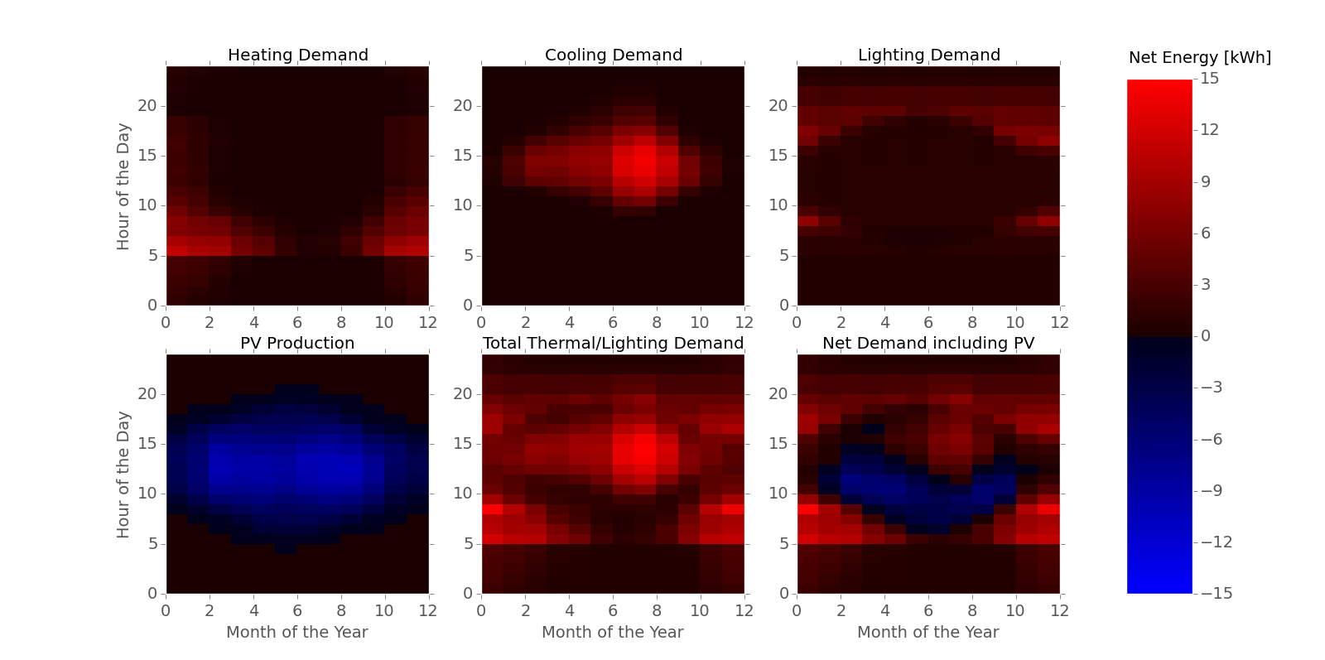
Net Energy Demand at Optimum Orientation

Slide 12
Overview
Introduction
Problem Description
Methodology
Results and Discussion
Conclusions and Outlook

Slide 13
Conclusions
Developed Simulation Framework for the ASF
Possibility to Include PV-Electricity Production
Optimal Angles for Single Cluster Found

Slide 14
Outlook
Development of Building Energy Simulation Tool
More In-Depth Analysis of PV-Electricity Production
Include Energy-Use for Actuation in Simulation
Use Multiple Clusters of PV-Panels

Slide 15
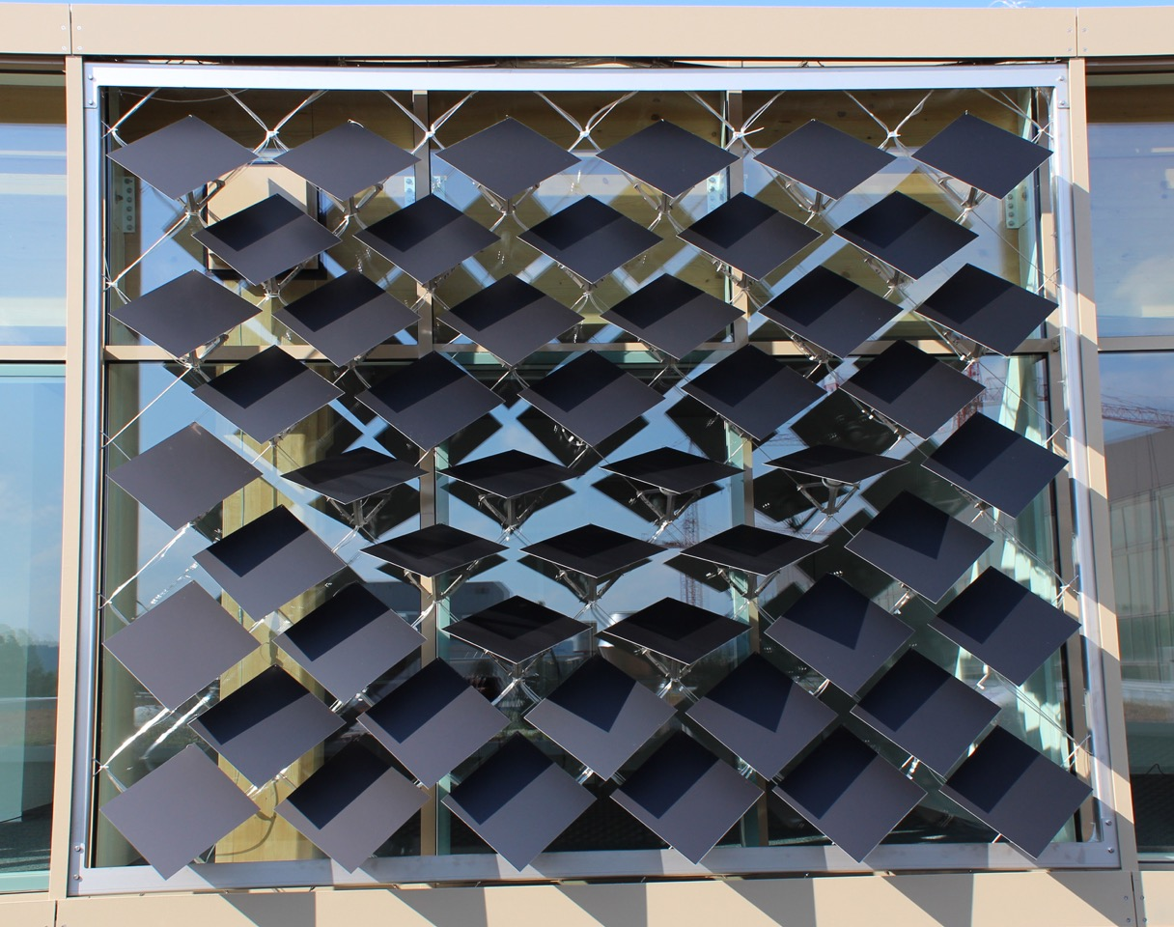

Slide 16
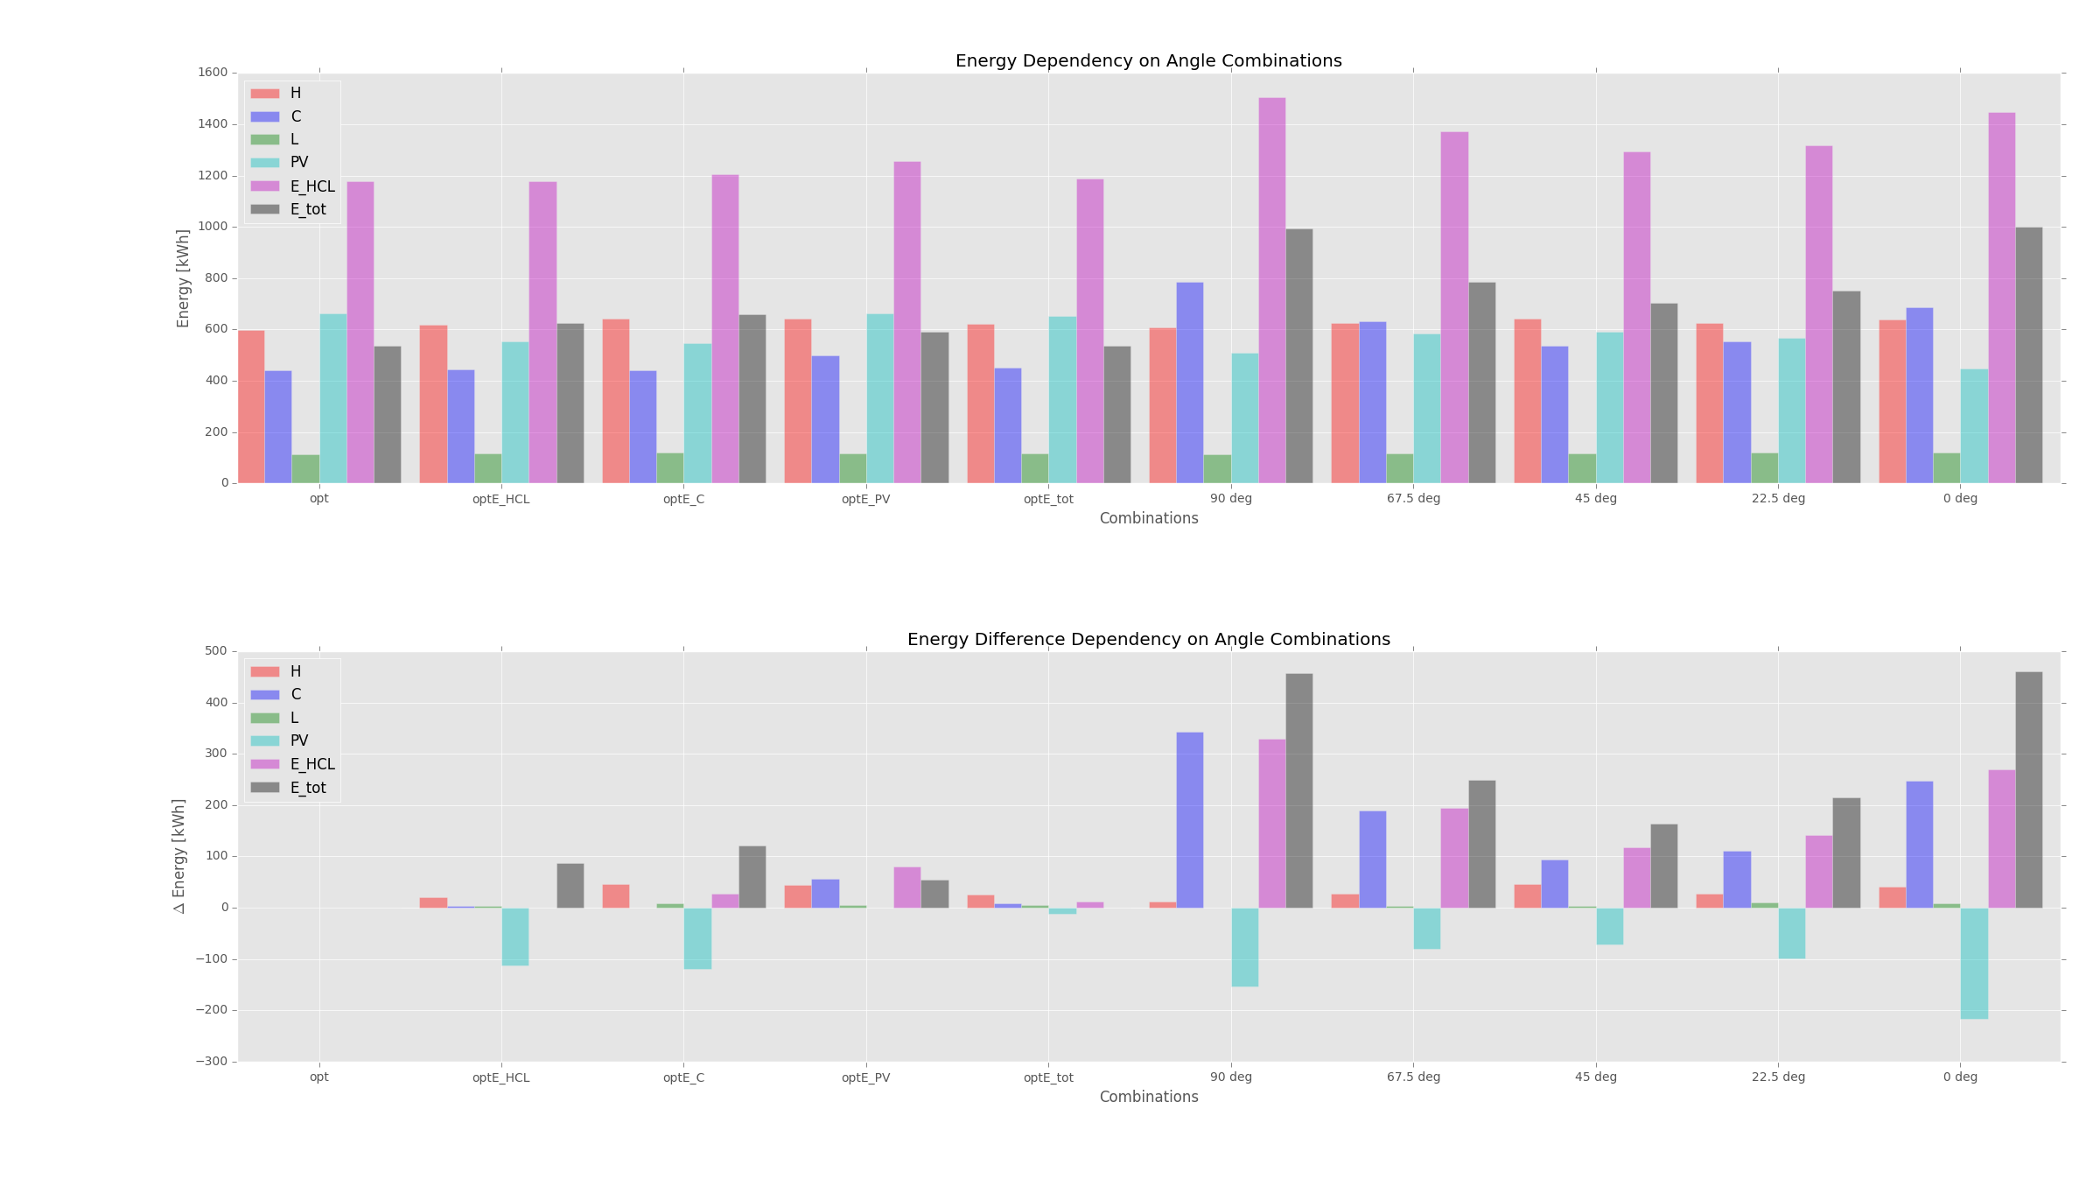
Heating COP = 3 Cooling COP = 3 Lighting = 3 W/m2 PV-efficiency = 0.072

Slide 17
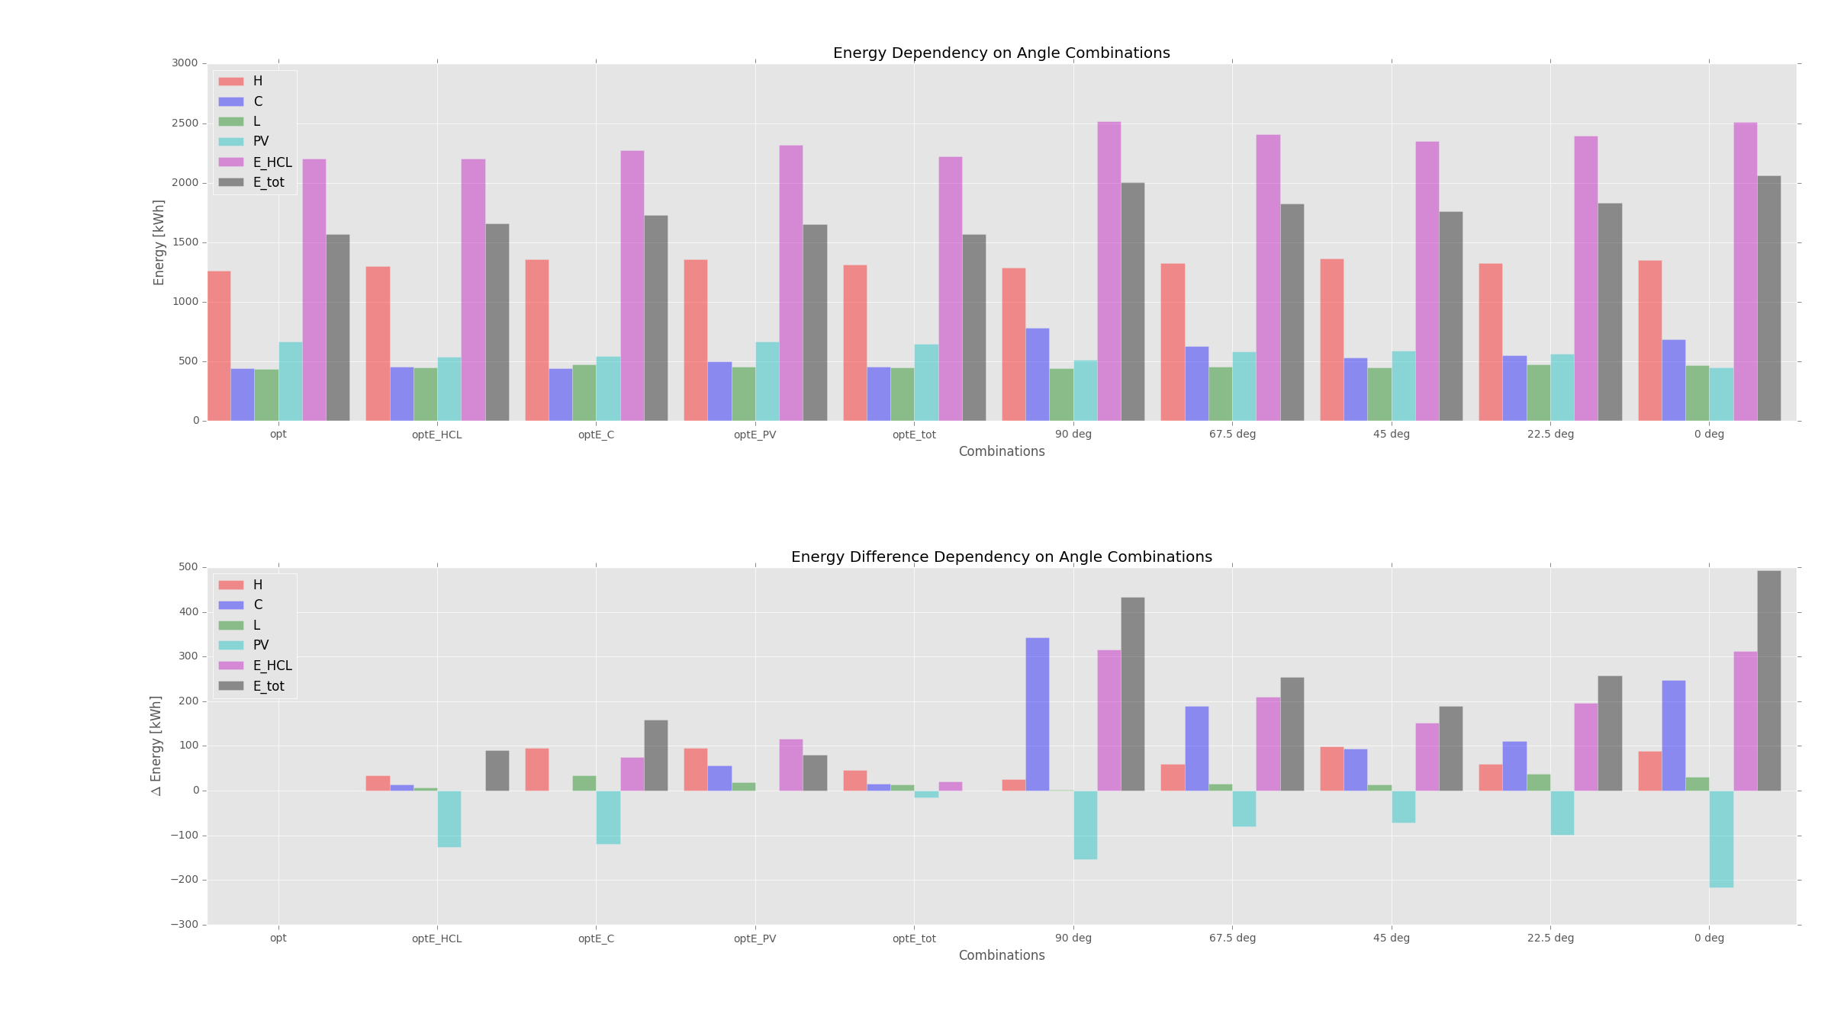
Heating COP = 0.85 Cooling COP = 3 Lighting = 11.74 W/m2 PV-efficiency = 0.072

Slide 18
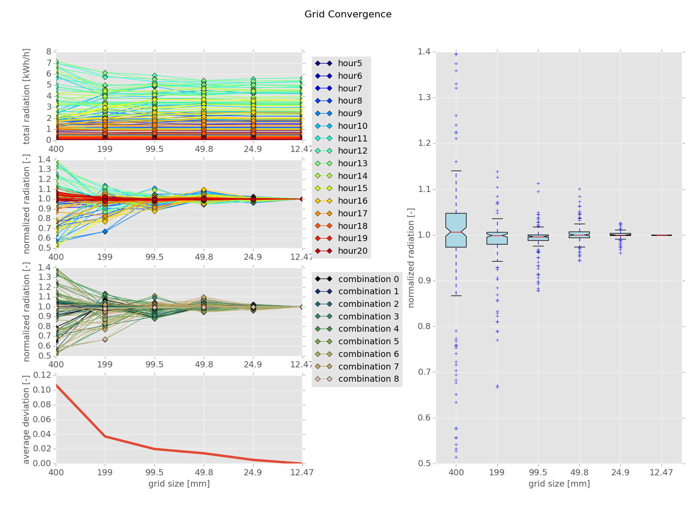
Conclusions
Developed Simulation Framework for the ASF
Optimum Angle Combinations Found
Possibility to Include PV-Electricity Production

Slide 19
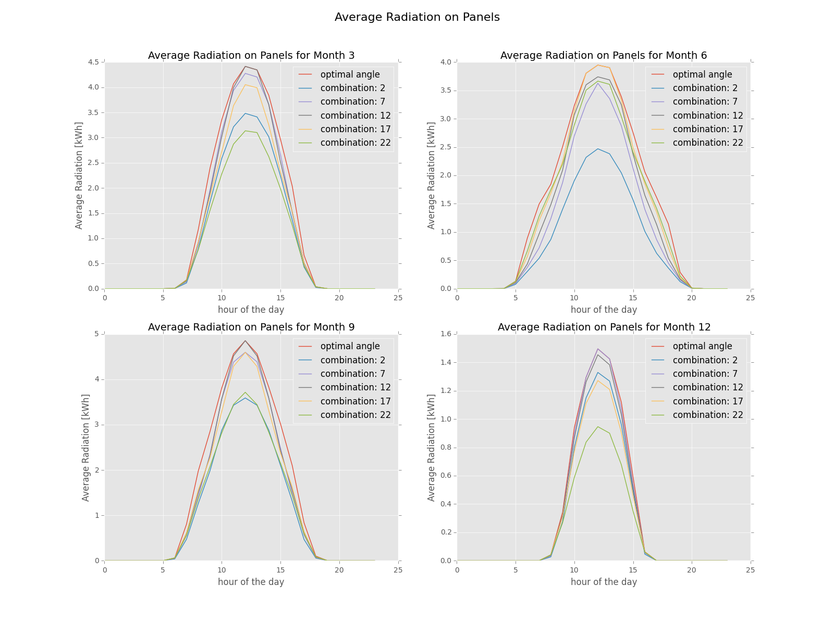
Conclusions
Developed Simulation Framework for the ASF
Optimum Angle Combinations Found
Possibility to Include PV-Electricity Production

Slide 20
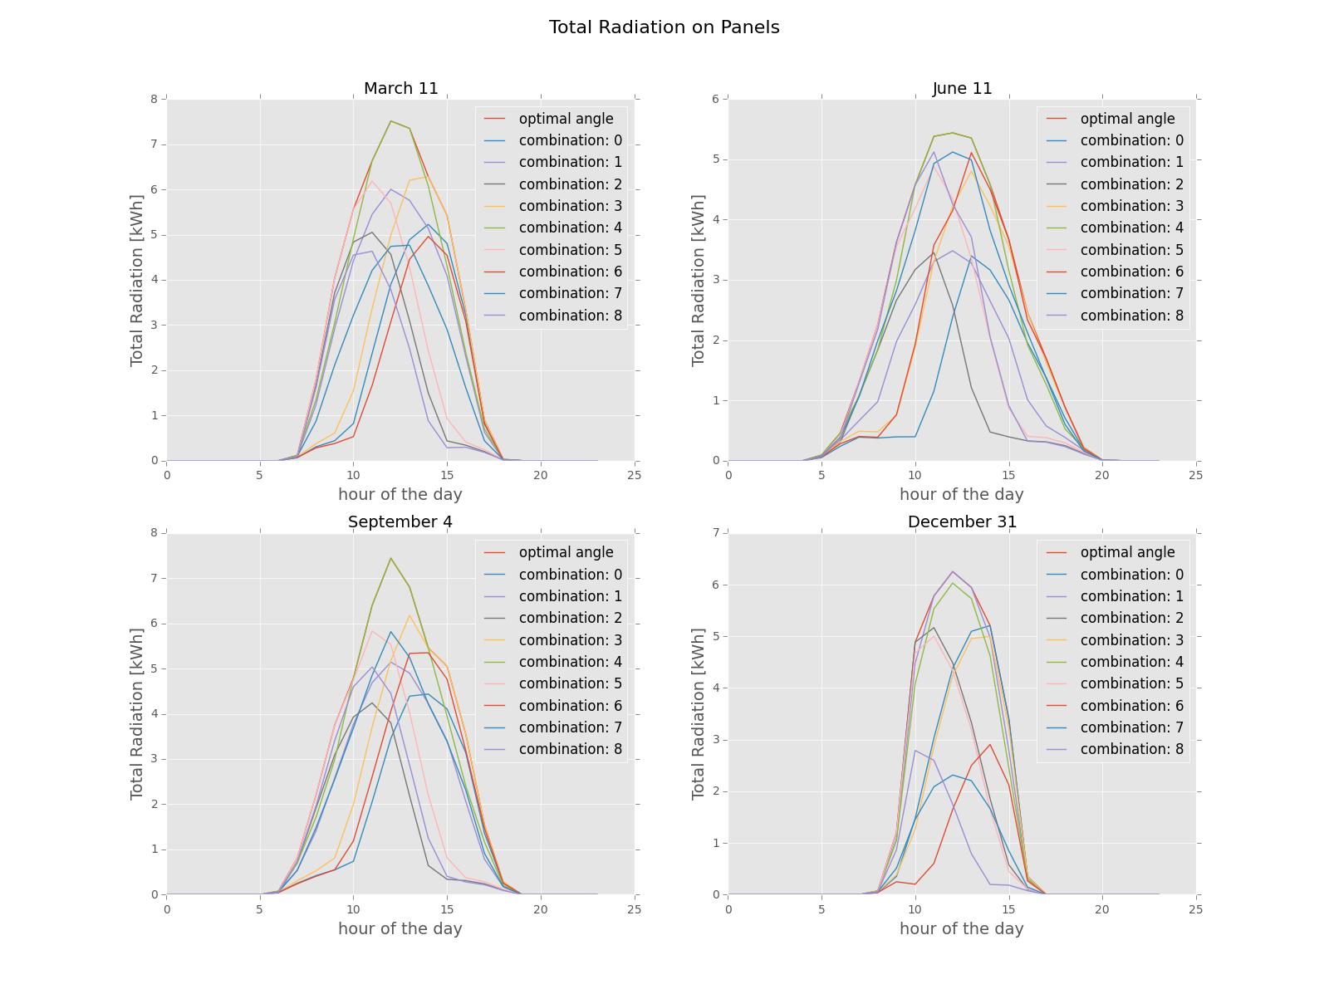
Conclusions
Developed Simulation Framework for the ASF
Optimum Angle Combinations Found
Possibility to Include PV-Electricity Production

